Slide 1

Nashville Housing Market
Kala Mckinney 12/20/2022

Slide 2
Motivation
I began my home-buying journey in late 2020/early 2021
Focused our search on Davidson County/Metro Nashville
My search statistics:
1 year total spent searching
Countless drive-bys
65 official showings
25 failed offers
Over 6,000 miles driven across Middle TN

Slide 3
Question
How did 2021 compare to previous years for homebuyers in Nashville, TN? Was my journey typical for everyone or was it just me?

Slide 4




Technologies Used

Slide 5
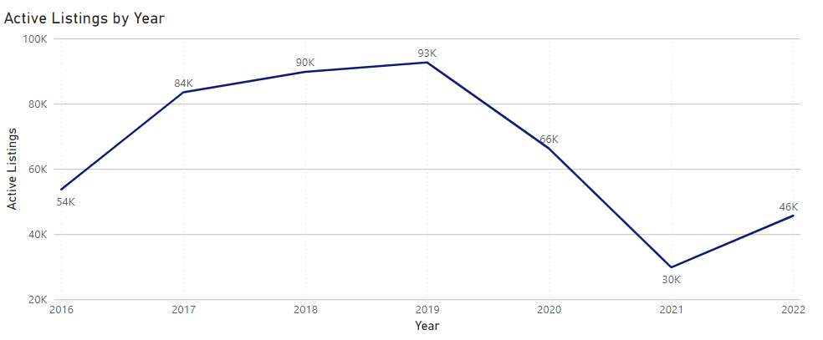
How has availability changed?
55% fewer houses listed in 2021 vs 2020; 68% vs 2019
35% increase in 2022 vs 2021

Slide 6
How has availability changed?
-68%
+35%
Notes:
55% fewer houses listed in 2021 vs 2020; 68% vs 2019
35% increase in 2022 vs 2021

Slide 7
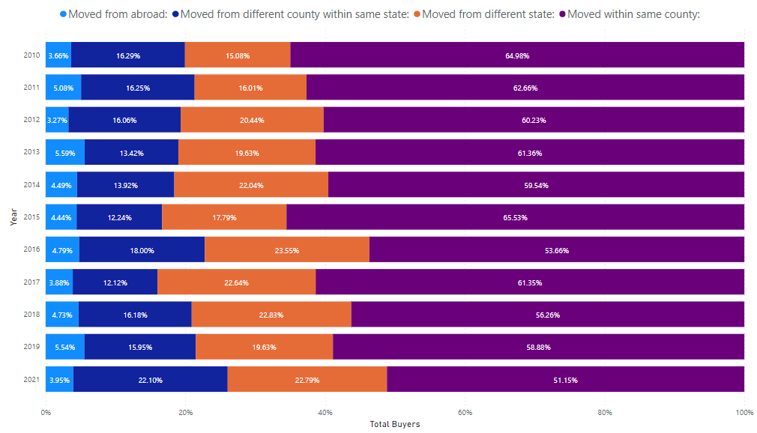
Where are these people coming from?
55% increase in people moving from another state
People moving from abroad has remained relatively flat

Slide 8
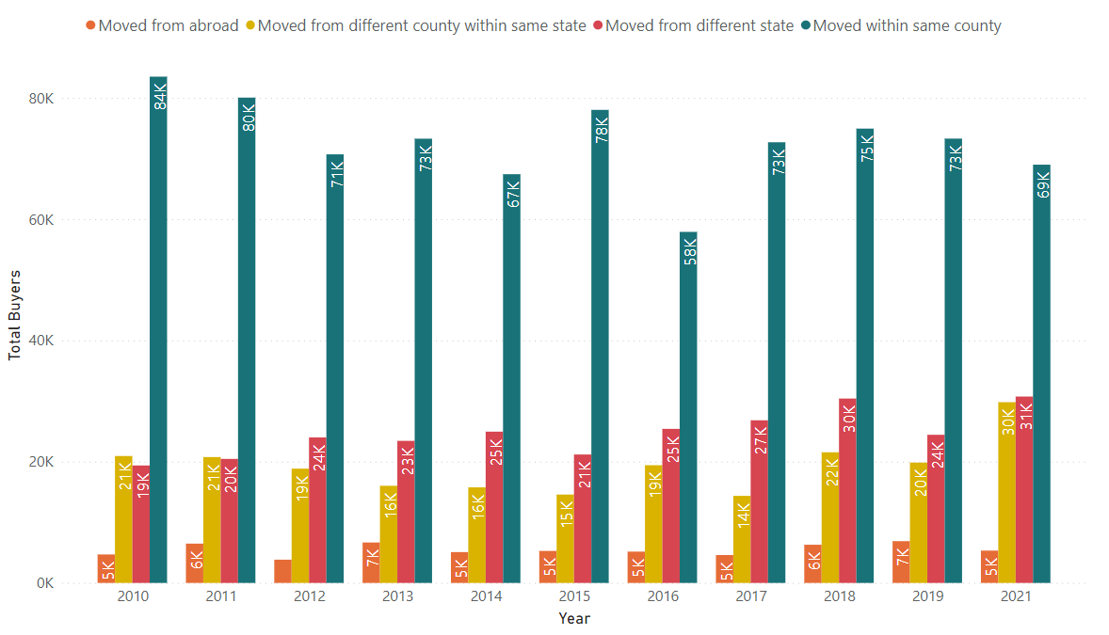
Where are these people coming from?

Slide 9
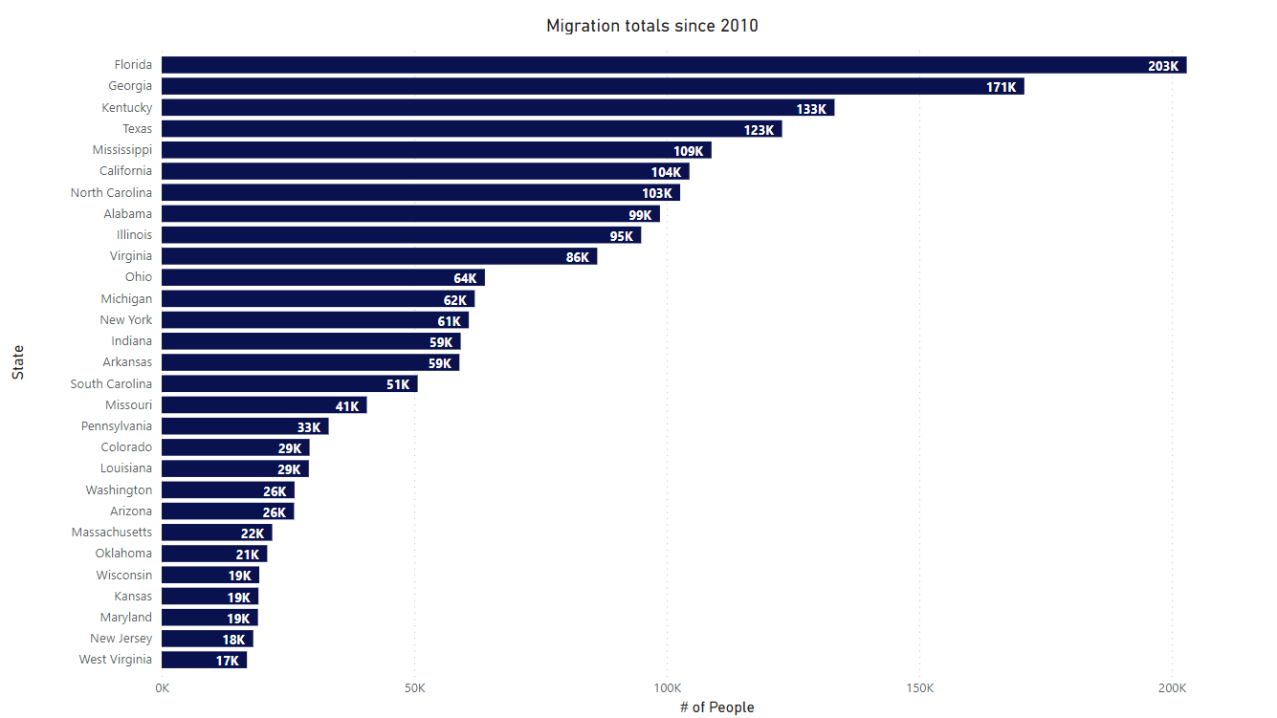
Where are these people coming from?

Slide 10
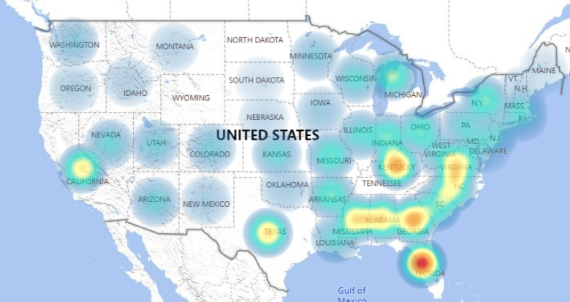
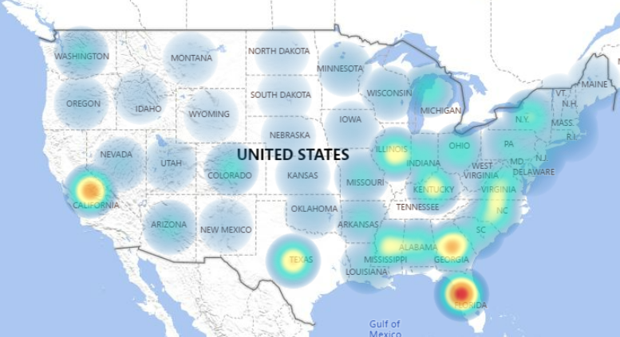
Migratory Patterns
2010
2020
Florida remains the biggest contributor for volume of new TN residents with 50% increase since 2010
For states showing 5K+ residents moving this way each year, Illinois (244%) and California (108%) have shown the most significant increase from 2010 to 2020, with trends expected to stay the same in 2022
Of the top 10 contributors for volume, Virginia (-4%), Kentucky (-7%), and Alabama (-12%) have all shown a decrease since 2010.

Slide 11
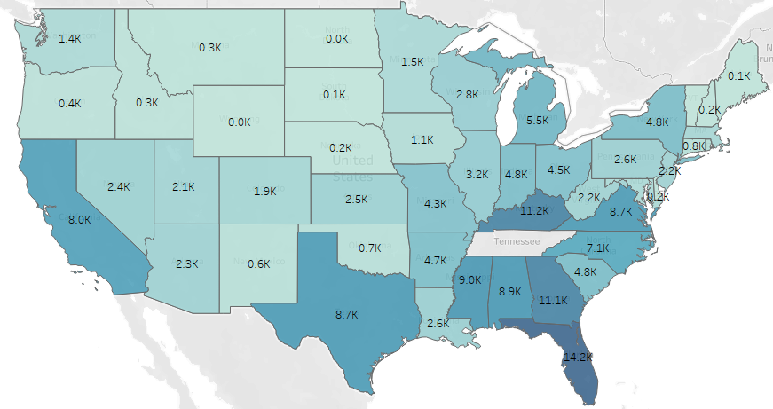
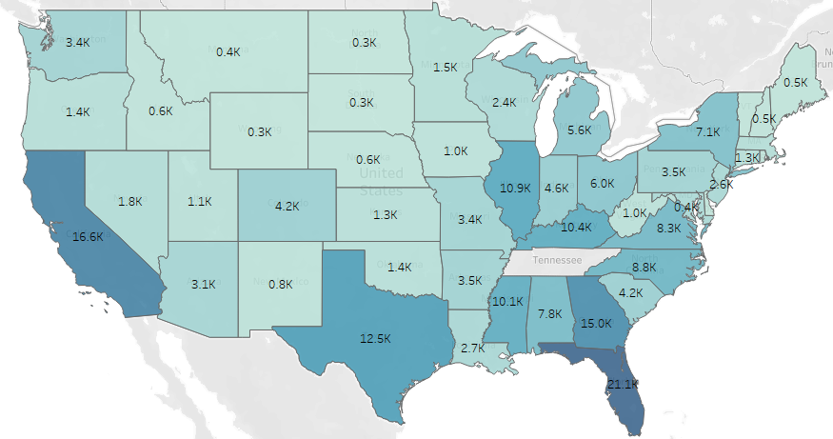
Migratory Patterns
2010
2020
Florida remains the biggest contributor for volume of new TN residents with 50% increase since 2010
For states showing 5K+ residents moving this way each year, Illinois (244%) and California (108%) have shown the most significant increase from 2010 to 2020, with trends expected to stay the same in 2022
Of the top 10 contributors for volume, Virginia (-4%), Kentucky (-7%), and Alabama (-12%) have all shown a decrease since 2010.
Notes:
Florida remains the biggest contributor for volume of new TN residents with 50% increase since 2010
For states showing 5K+ residents moving this way each year, Illinois (244%) and California (108%) have shown the most significant increase from 2010 to 2020, with trends expected to stay the same in 2022
Of the top 10 contributors for volume, Virginia (-4%), Kentucky (-7%), and Alabama (-12%) have all shown a decrease since 2010.

Slide 12
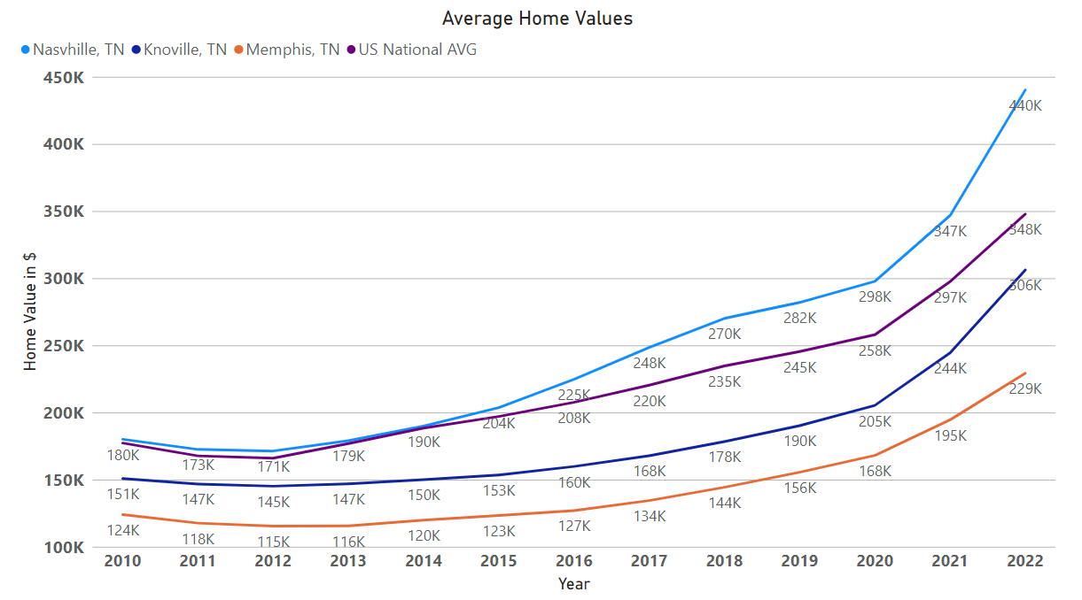
How does Nashville compare?
National home values rose 35% in from 2020 to 2022
Nashville home values rose 48% from 2020 to 2022
As of 2022, Nashville home prices are 26% higher than the national average

Slide 13
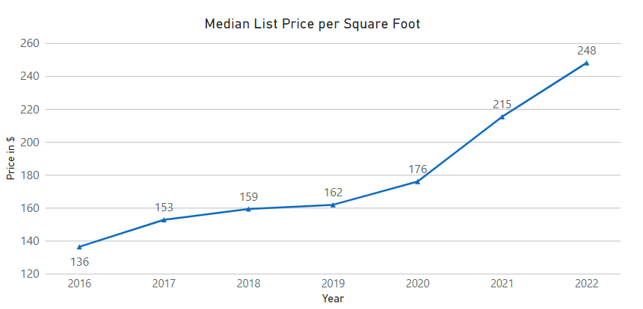
Buying Trends
+41%
Average +7% YoY

Slide 14
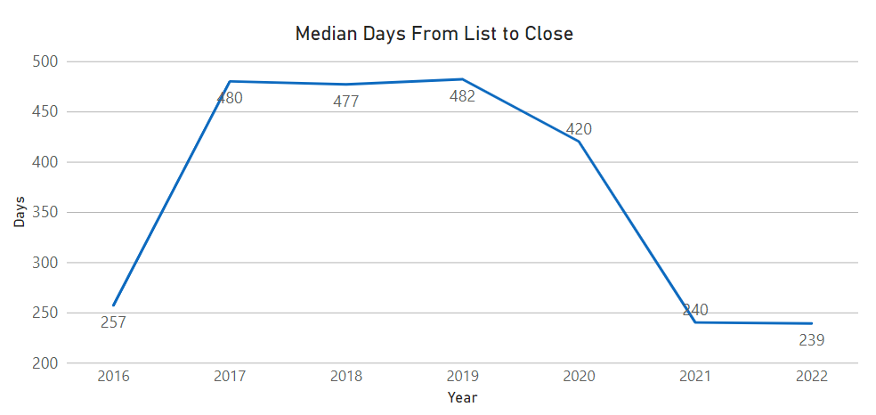
Buying Trends
-43%

Slide 15
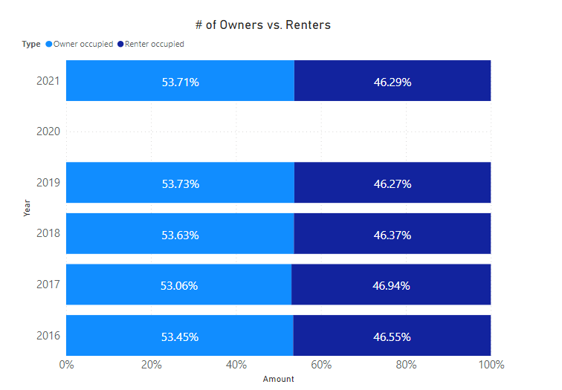
Are more people renting than buying?

Slide 16
Sources
Zillow Housing Research
US Census Data
Davidson County Assessors Data

Slide 17
Challenges & Next Steps
Challenges:
Census data for migratory patterns not available beyond 2020
Listing details unavailable prior to 2016 (for free)
Next Steps:
% of homes sold above/under list price and by how much
How many homes were purchased and resold within 1 year and the price differences between
Distribution of “homes” purchased that were single family/condo/new construction
Break up the trends by price bands
National Average for all metrics

Slide 18
Conclusions
2021 was the most difficult year in the past 10 years in Nashville to purchase a home
Nashville remains one of the most competitive and pricey home markets in the nation
If you have a time machine, go back to roughly 2010, or even 2019 and buy a house
If you have friends in FL, IL, or CA, tell them not to move here
Notes:
COVID drove a significant increase in home-buying activity which led to a drastic decrease in available inventory. Due to a growing job market from business friendly legislation, lower than average property taxes, and friendly climate, Nashville was listed as one of the pandemic “boom towns” during this surge (The Home Buying Institute; 2022)

